Slide 1

SOLUTION OF NON-LINEAR EQUATION
CHAPTER 1

Slide 2
INTRODUCTION
algebraic equation, statement of the equality of two expressions formulated by applying to a set of variables the algebraic operations, namely, addition, subtraction, multiplication, division, raising to a power, and extraction of a root. Examples are x³ + 1 and (y⁴x² + 2xy – y)/(x – 1) = 12. An important special case of such equations is that of polynomial equations, expressions of the form ax^{n} + bx^{n − 1} + … + gx + h = k. They have as many solutions as their degree (n), and the search for their solutions stimulated much of the development of classical and modern algebra. Equations like x sin (x) = c that involve nonalgebraic operations, such as logarithms or trigonometric functions, are said to be transcendental.

Slide 3

Which is a transcendental equation?
An equation containing polynomials, logarithmic functions, trigonometric functions, and exponential functions is known as transcendental equation. tanx−ex=0,sinx−xe2x=0,andxex=cosx. are some of the transcendental equations examples.

Slide 4
FIXED POINT ITERATIVE METHOD
The fixed point iteration method in numerical analysis is used to find an approximate solution to algebraic and transcendental equations. Sometimes, it becomes very tedious to find solutions to cubic, bi-quadratic and transcendental equations; then, we can apply specific numerical methods to find the solution; one among those methods is the fixed point iteration method.
The fixed point iteration method uses the concept of a fixed point in a repeated manner to compute the solution of the given equation. A fixed point is a point in the domain of a function g such that g(x) = x. In the fixed point iteration method, the given function is algebraically converted in the form of g(x) = x.

Slide 5
Fixed Point Iteration Method
Suppose we have an equation f(x) = 0, for which we have to find the solution. The equation can be expressed as x = g(x). Choose g(x) such that |g’(x)| < 1 at x = x_{o} where x_{o,}is some initial guess called fixed point iterative scheme. Then the iterative method is applied by successive approximations given by x_{n} = g(x_{n – 1}), that is, x₁ = g(x_{o}), x₂ = g(x₁) and so on.
Algorithm of Fixed Point Iteration Method
Choose the initial value x_{o} for the iterative method. One way to choose x_{o} is to find the values x = a and x = b for which f(a) < 0 and f(b) > 0. By narrowing down the selection of a and b, take x_{o} as the average of a and b.
Express the given equation, in the form x = g(x) such that |g’(x)| < 1 at x = x_{o}. If there more than one possibility of g(x), choose the g(x) which has the minimum value of g’(x) at x = x_{o}.
By applying the successive approximations x_{n} = g(x_{n – 1}), if f is a continuous function, we get a sequence of {x_{n}} which converges to a point l_{o}, which is the approximate solution of the given equation.

Slide 6

Important Facts
Some interesting facts about the fixed point iteration method are
The form of x = g(x) can be chosen in many ways. But we choose g(x) for which |g’(x)|<1 at x = x_{o}.
By the fixed-point iteration method, we get a sequence of x_{n,} which converges to the root of the given equation.
Lower the value of g’(x), fewer the iterations are required to get the approximate solution.
The rate of convergence is more if the value of g’(x) is smaller.
The method is useful for finding the real roots of the equation, which is the form of an infinite series.
The type of convergence seen is linear.

Slide 7

PROCEDURE TO FIND INITIAL APPROXIMATION
WHAT IS INITIAL APPROXIMATION ?
a roughly approximate value of a quantity often preliminary to more precise determination
FOR eg.the value of pi to a first approximation is ²²/₇

Slide 8
METHODS FOR DETERMINING APPROXIMATE SOLUTION
An analytical approach is used to find the exact solution to a problem but for complex systems the math can become too complicated.
A graphical approach is used to find an approximate solution to a problem by viewing an interpreting a graphical image accordingly.
A numerical approach is used to find an approximate solution to a problem but may be simpler than an analytical approach.

Slide 9
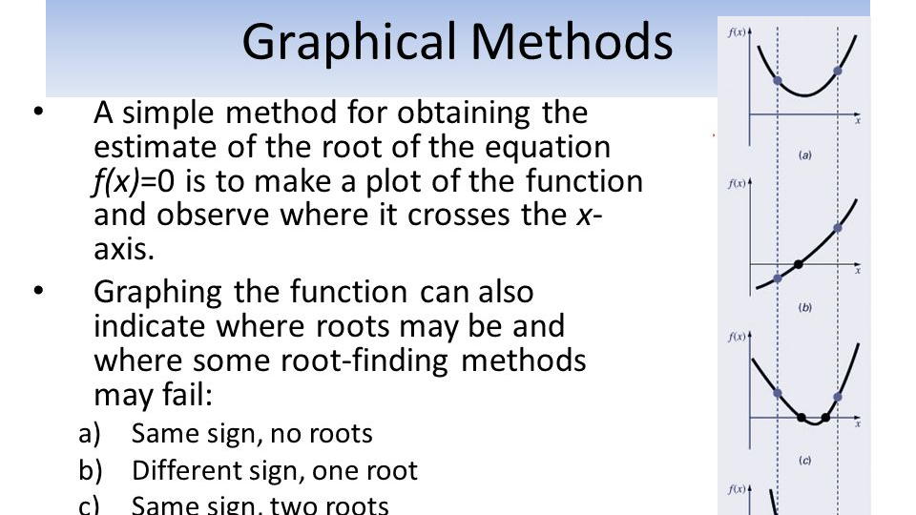

Slide 10
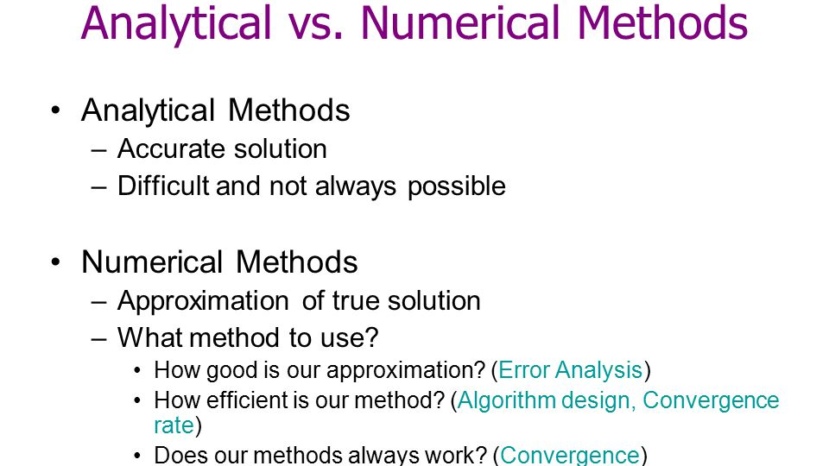

Slide 11
Termination Criteria
A termination criterion is needed to stop the iterative process of the Nelder–Mead algorithm. If any of the following three criterion is satisfied the algorithm is terminated:
1.
Domain convergence test: When the simplex is sufficiently small in some sense (some or all the vertices xj are close enough), the iteration is terminated.
2.
Function value convergence test: When all the function values, fj are close enough in some sense, the iteration is terminated.
3.
Limit on number of iterations: When the limit on number of iterations or number of function evaluations exceeds a specified value, the iteration is terminated.

Slide 12
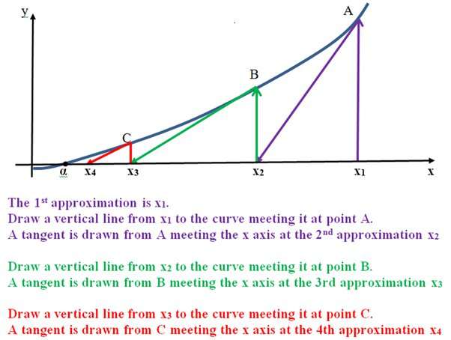

Slide 13

The order of convergence of an iterative method is the order of the corresponding sequence. If it is , then the method approximately multiplies by the number of correct decimals after each iteration.

Slide 14
The bisection method
is used to find the roots of a polynomial equation. It separates the interval and subdivides the interval in which the root of the equation lies. The principle behind this method is the intermediate theorem for continuous functions. It works by narrowing the gap between the positive and negative intervals until it closes in on the correct answer. This method narrows the gap by taking the average of the positive and negative intervals. It is a simple method and it is relatively slow. The bisection method is also known as interval halving method, root-finding method, binary search method or dichotomy method.

Slide 15
BISECTION METHOD ALGORITHM
Follow the below procedure to get the solution for the continuous function:
For any continuous function f(x),
Find two points, say a and b such that a < b and f(a)* f(b) < 0
Find the midpoint of a and b, say “t”
t is the root of the given function if f(t) = 0; else follow the next step
Divide the interval [a, b] – If f(t)*f(a) <0, there exist a root between t and a
– else if f(t) *f (b) < 0, there exist a root between t and b
Repeat above three steps until f(t) = 0.
The bisection method is an approximation method to find the roots of the given equation by repeatedly dividing the interval. This method will divide the interval until the resulting interval is found, which is extremely small.

Slide 16
Bisection Method Example
Question: Determine the root of the given equation x²-3 = 0 for x ∈ [1, 2]
Solution:
Given: x²-3 = 0
Let f(x) = x²-3
Now, find the value of f(x) at a= 1 and b=2.
f(x=1) = 1²-3 = 1 – 3 = -2 < 0
f(x=2) = 2²-3 = 4 – 3 = 1 > 0
The given function is continuous, and the root lies in the interval [1, 2].
Let “t” be the midpoint of the interval.
I.e., t = (1+2)/2
t =3 / 2
t = 1.5
Therefore, the value of the function at “t” is
f(t) = f(1.5) = (1.5)²-3 = 2.25 – 3 = -0.75 < 0
If f(t)<0, assume a = t.
and
If f(t)>0, assume b = t.
f(t) is negative, so a is replaced with t = 1.5 for the next iterations.

Slide 17
The iterations for the given functions are:
Iterations | a | b | t | f(a) | f(b) | f(t)
1 | 1 | 2 | 1.5 | -2 | 1 | -0.75
2 | 1.5 | 2 | 1.75 | -0.75 | 1 | 0.062
3 | 1.5 | 1.75 | 1.625 | -0.75 | 0.0625 | -0.359
4 | 1.625 | 1.75 | 1.6875 | -0.3594 | 0.0625 | -0.1523
5 | 1.6875 | 1.75 | 1.7188 | -01523 | 0.0625 | -0.0457
6 | 1.7188 | 1.75 | 1.7344 | -0.0457 | 0.0625 | 0.0081
7 | 1.7188 | 1.7344 | 1.7266 | -0.0457 | 0.0081 | -0.0189

Slide 18
So, at the seventh iteration, we get the final interval [1.7266, 1.7344]
Hence, 1.7344 is the approximated solution.

Slide 19
Advantages of Bisection Method
Guaranteed convergence. The bracketing approach is known as the bisection method, and it is always convergent.
Errors can be managed. Increasing the number of iterations in the bisection method always results in a more accurate root.
Doesn't demand complicated calculations. There are no complicated calculations required when using the bisection method. To use the bisection method, we only need to take the average of two values.
Error bound is guaranteed. There is a guaranteed error bound in this technique, and it reduces with each repetition. Each cycle reduces the error bound by 12 per cent.
The bisection method is simple and straightforward to programme on a computer.
In the case of several roots, the bisection procedure is quick.

Slide 20

Disadvantages of Bisection Method
Although the Bisection method's convergence is guaranteed, it is often slow.
Choosing a guess that is close to the root may necessitate numerous iterations to converge.
Some equations' roots cannot be found. Because there are no bracketing values, like f(x) = x².
Its rate of convergence is linear.
It is incapable of determining complex roots.
If the guess interval contains discontinuities, it cannot be used.
It cannot be applied over an interval where the function returns values of the same sign.

